Slide 1
Teacher interview highlights
By Sara Villa

Slide 2
Western Music Alumni
Bachelors in Music Education
Played piano since childhood
Began playing bassoon in high school
Played bassoon at Western and still does today

Slide 3
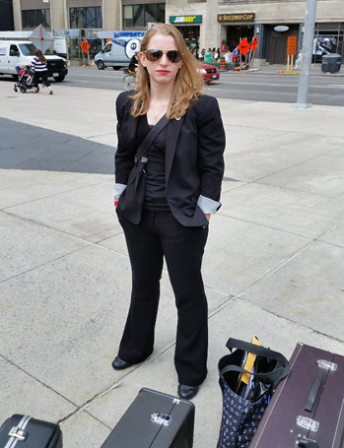
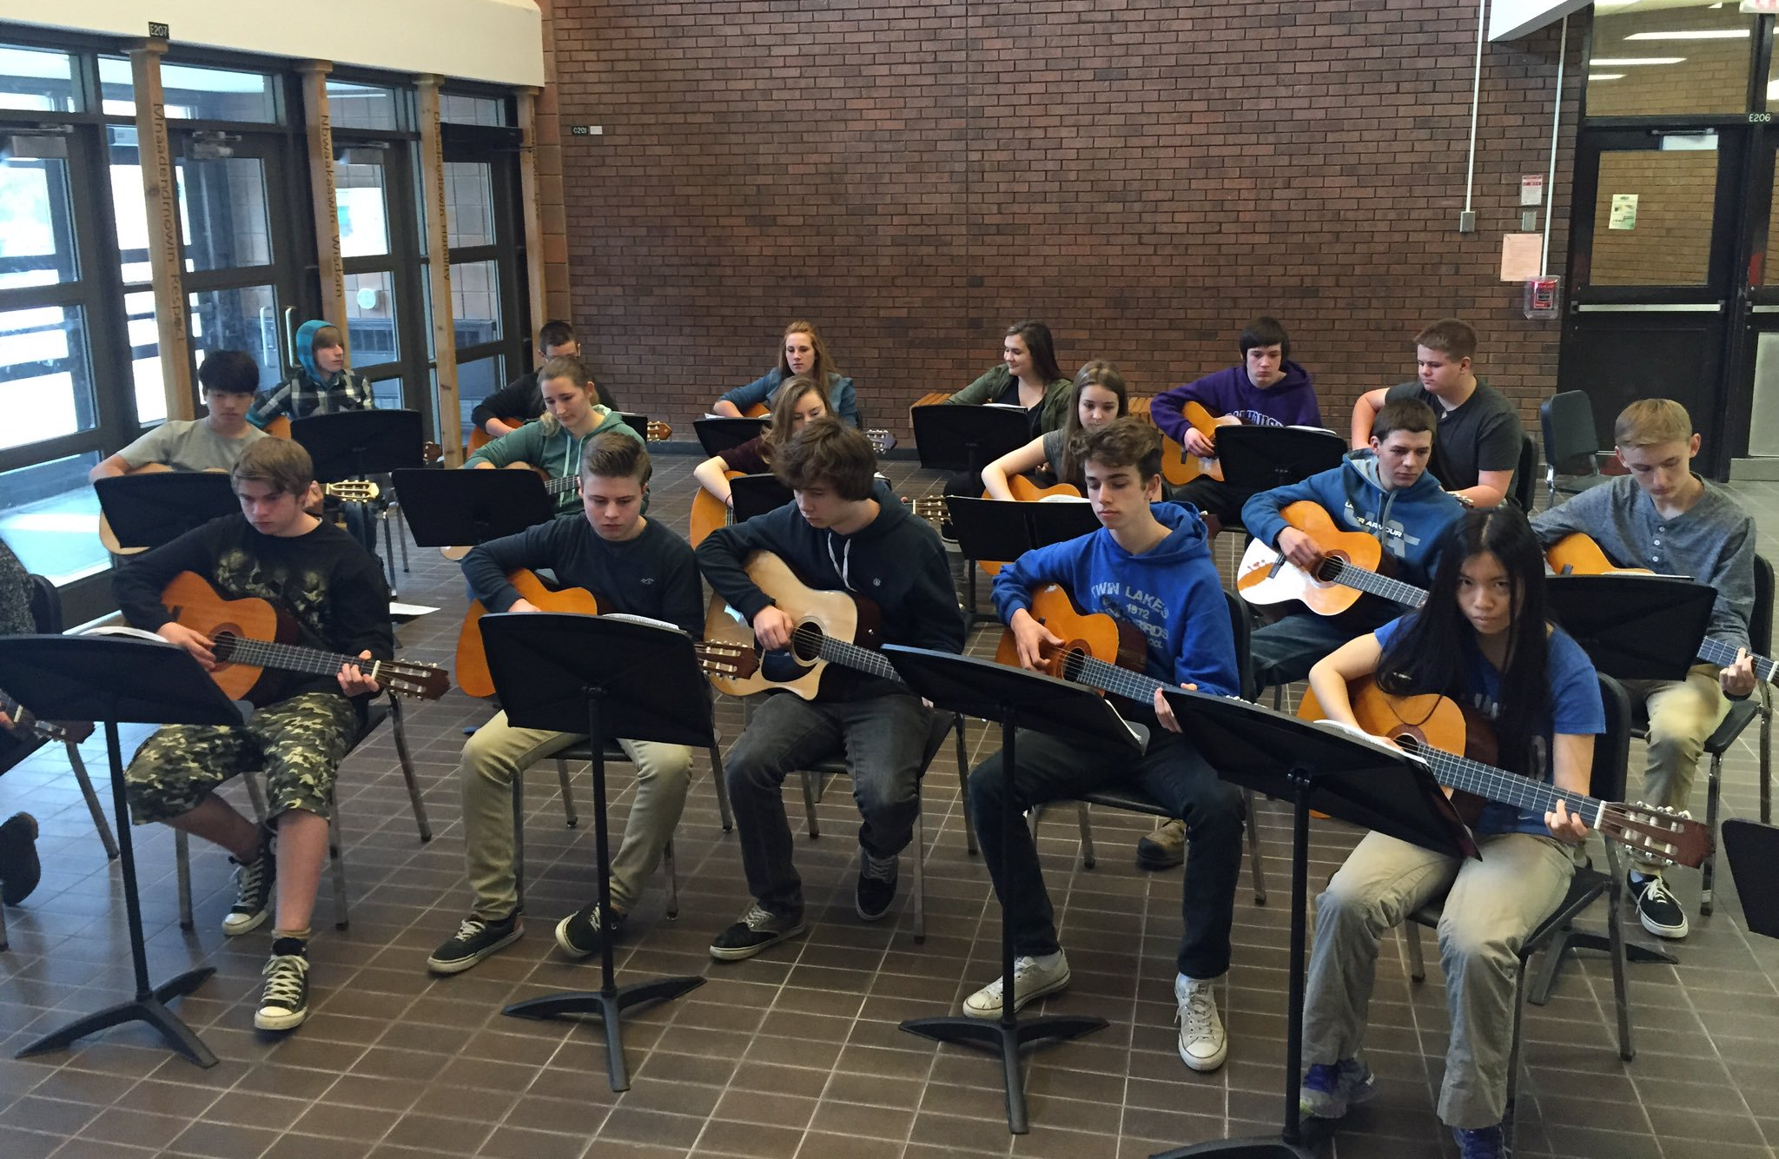
To me, Ms. V was:
A fantastic symphonic band director
A great classroom teacher for grades 10, 11 & 12 guitar
A mentor who pushed my musical ability outside the classroom and into the community

Slide 4
